Slide 1
LXI Networking Basics
LAN eXtentions for Instrumentation
LXI Consortium Presentation
Aug 5, 2017
Notes:
Welcome to this series of presentations on LXI.. This is a summary presentation of Networking Basics providing only as much information as is needed to understand the use of LXI Devices in a typical LAN environment.

Slide 2
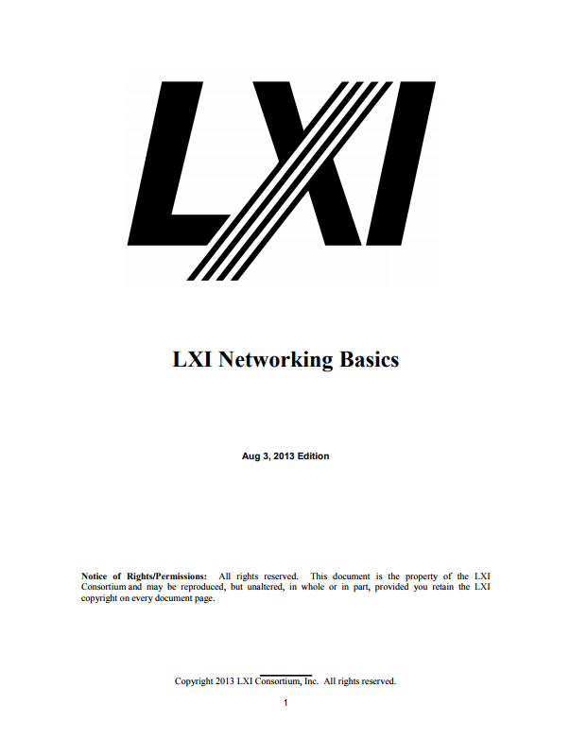
LXI Networking Basics
LAN eXtentions for Instrumentation
LXI Consortium Presentation
Aug 5, 2017
Notes:
Content of this video comes from the LXI Networking Basics, found on the LXI Consortium web site.
The last slide in this presentation gives you a specific URL to locate this and other LXI Learning documents.

Slide 3
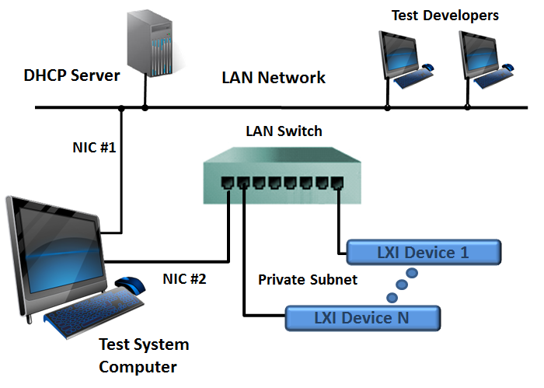
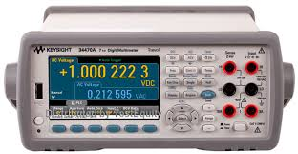

Typical Test System LAN Configuration
Understand basic LAN Connectivity
Understand the basic LAN operation of LXI Devices
Notes:
A network is a group of devices, such as computers, printers, LXI Devices, etc., that are interconnected with each other.
The LAN configuration shown is actually the recommended configuration for building an LXI-based Test System.
This presentation will help you understand basic LAN connectivity and how LXI Devices operate when connected to a LAN, so you can better understand how such a system operates.

Slide 4
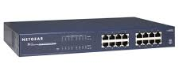
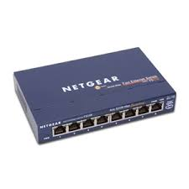
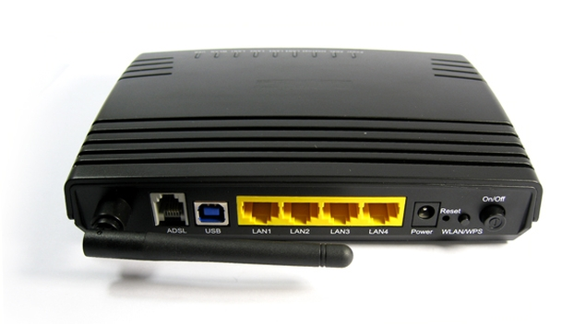
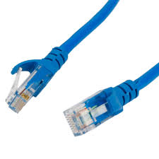
LXI Device, Cables, Switches, Hubs, Routers…
Notes:
Each LXI Device usually contains a built-in LAN interface, but the LAN interface could also be a plug-in accessory. This figure shows an LXI Device with multiple interfaces, including LAN. The LAN cable connects to the RJ45 connector of one LAN device to other LAN devices through cables, a Hub, Switch, or Router.
Notice the locking features of a typical RJ45 LAN Connector, which serves to protect against accidental disconnection.

Slide 5
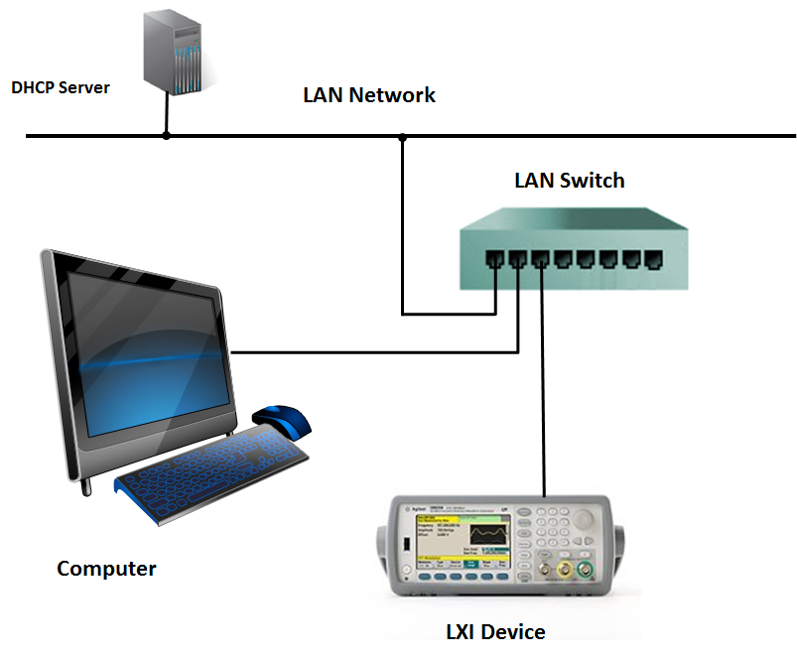

OSI Networking Layers…
Notes:
The Open Systems Interconnection model (OSI) helps you to think of networking in terms of abstraction layers. Different communication technologies with similar functions group into different logical layers on the OSI Model. Each layer of the OSI Model makes use of functions provided by the layers below it and provides functions used by the layers above it.
The LXI Specification focuses on Layers 1 – 3. The LAN Hub, Switch, and Router are the primary interconnecting LAN devices. These devices have multiple ports and allow multiple LAN Devices to be interconnected.

Slide 6


LAN Switch vs. Hub…
Electrical Signals
Layer 1
MAC Addresses
Layer 2
Notes:
The Hub and Switch look identical, but they are quite different. The LAN Hub is a Layer 1 device, which means it is involved with the electrical signals sent over the LAN cable, also a part of Layer 1. The Hub sends the signals from one LAN port to all its other ports. Every LAN Device connected to a Hub sees the traffic from every other LAN Device. This causes collisions and slows down communication, since every device on the Hub must share access to the same signal path. LAN handles collisions using a method referred to as 802.3 CSMA/CD where each LAN Device must detect collisions and withdraw access for a random time before retrying. Adding more devices to a Hub simply increases the chance of collisions on the LAN.
The LAN Switch operates at the Layer 2 level, where it keeps track of which LAN Device connects to each port by noting its MAC address during initial communication from the devices. The MAC address is a 12-digit hexadecimal number used to create a unique hardware address for a LAN Device (MM:MM:MM:SS:SS:SS). The first half of the address represents the manufacturer or vendor of the device.
LAN Hubs are rare but still available and used for monitoring the traffic between devices when debugging or analyzing LAN traffic. A typical Layer 2 Switch does not allow this capability since it isolates traffic between ports. However, commercial-grade LAN Switches do provide a concept called Port Mirroring to allow a LAN analyzer to monitor the traffic of any port.
LAN analyzers can be a stand-alone product or software running on a computer using the computer’s LAN interface. The LXI Consortium members often use a network protocol analyzer called Wireshark (www.wireshark.org)

Slide 7
Connect – pretty much just like a PC
What happens?
Computer and LXI Device ask DHCP Server for an IP address
Notes:
This configuration was covered in the Connecting with LXI presentation. It is simple. You plug the device into the company’s LAN, and the DHCP server gives it an IP address…pretty much like a computer.
In this case, your fancy new LXI Device is also accessible to every other computer on the network, because you used a LAN Switch to extended the LAN ports connected to the company LAN.

Slide 8
More on Switch LAN Connections…
What happens?
Computer and LXI Device ask DHCP Server for an IP address – none found
They both drop into AutoIP configuration
169.254.x.x addresses
Notes:
This illustrates what happens when the connection to the company LAN is broken. The Computer and LXI Device automatically ask for an IP address. However, the DHCP Server does not see their requests because of the broken connection to the company LAN. Since the LAN Devices connect to the LAN Switch, there actually is a “LAN” connection, and they will wait about 2 minutes before taking things into their own hands. At that point, they will begin broadcasting an AutoIP address (169.254.x.x for an IPv4 address). If an IP address is already in use, the inquiring LXI Device will pick another IP address until it finds a unique one.
If a LAN Device has no connection to another LAN Device, it will recognize no connection and automatically come up with an IP Address of 0.0.0.0, and indicate with an LED or a message on its Front Panel display that no LAN connection exists, which refers to a LAN Status Fault in the LXI Specification. Note that the same AutoIP process occurs if you directly connect one LAN Device to another. For example, you could directly connect the Computer to the LXI Device, and both will settle on some 169.254.x.x address after about 2 minutes. If either LAN Device has Auto-MDIX or a Gigabit interface, there is no need for a crossover cable to switch TX and RX lines for proper communication.

Slide 9
Using a Router with built-in Switch…
156.140.x.x
192.168.1.x
Notes:
The LAN Router gets its IP Address from the DHCP Server on the company LAN, which in this example is setup to supply IP addresses in the range of 156.140.x.x. This happens through the single port called “Internet”. The Computer and LXI Device get their IP addresses from the LAN Router, which comes equipped with a DHCP Server built into the product. IP addresses are typically in the range of 192.168.1.x from the LAN Router. The LAN Router’s Configuration page permits changing this range of addresses.
The “Ethernet” side of the LAN Router is where the protected LAN Devices exist. They are isolated from the company LAN Network, because other devices do not know they exist unless the devices on the “Ethernet” side communicate with them directly. For example, the Computer can access www.lxistandard.org with its Web Browser, and the Router will package up the request and send it out on the LAN as though the Router actually made the request. The response information returns to the Router’s IP address, which then unpacks the information and delivers it to the Computer’s IP address on the “Ethernet” side.

Slide 10
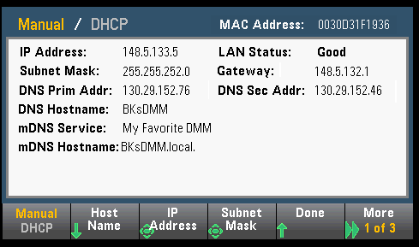
IP Address vs Hostname…
Note: LXI Specification also supports IPv6 addressing
Notes:
Here is an example of a front panel screen from an LXI Device, showing its connection information: IP Address, LAN Status, MAC Address, Hostname, etc.
The MAC address is the hardware address of a LAN Device, and LAN Switches keep track of MAC addresses to reduce LAN traffic. For many test system developers, the IP (Internet Protocol) Address is the primary means of communication. The IP address comes from a DHCP Server, automatically generated by the LAN Device itself (AutoIP), or it can be a static number manually configured by the User.
The IP Address can also be associated with a Hostname. Hostnames are human-readable nicknames that correspond to the IP Address of a device connected to a network: “BKsDMM” or “Lab1SpecAnalyzer”. Every LXI Device is required to have a Hostname, and when it connects to the LAN, it will acquire an IP Address associated with that Hostname.
This is also an example of the mDNS discovery protocol, showing the Hostname and Service Name – as used typically by printers – which is required by the LXI Specification. In this case, you can actually identify a particular product on the LAN by its Service Name, such as “My Favorite DMM”. For printers, you would typically present a location description.

Slide 11
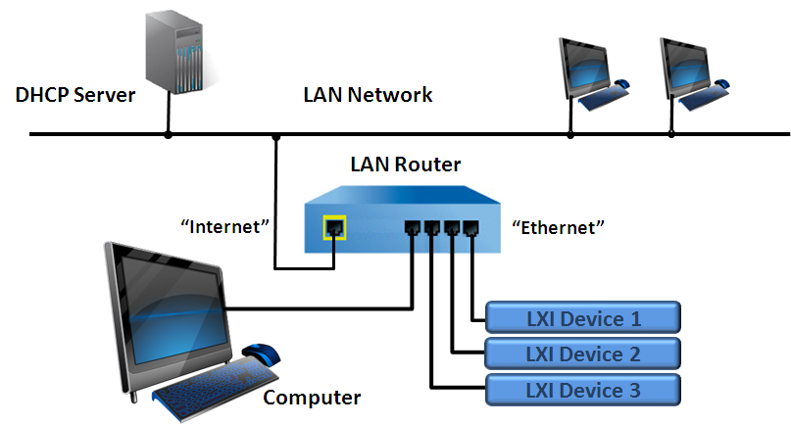
A Subnet on the LAN…
LAN segment to create a “Subnet”
IP Address 192.168.1.1 11000000 10101000 00000001 00000001
Subnet 255.255.255.128 11111111 11111111 11111111 10000000
Example:
LAN Device 1 = 192.168.0.1
LAN Device 2 = 192.168.0.2
LAN Device 3 = 192.168.0.140
Subnet Mask = 255.255.255.128
LAN Device 3 is not in the same subnet as 1 and 2,
because 192.168.0.140 is greater than 192.168.0.128.
Note that IPv6 is also part of the LXI Standard
Notes:
A Subnet Mask is a number that defines a range of IP addresses used in a network. Subnet masks designate sub-network segments, or subnets. LAN Devices within the same subnet can communicate directly with each other, while systems on different subnets communicate through a Router using a Gateway IP Address.
Subnet masks have to be contiguous 1’s followed by contiguous 0’s.
In this example, the built-in DHCP Server of the Router is setting the Subnet Mask, and each LXI Device will be told what IP Address and Subnet Mask to use if they are configured to automatically acquire an address from a DHCP Server. If you added LXI Device 3 with a static IP Address outside the range of the Subnet mask, you would not have a proper connection between the Computer and that device, since its IP address is 140 – outside the range of 1-128.
Note that the LXI Specification also includes IPv6 as optional for devices. The specifics of that protocol is outside the scope of this presentation.

Slide 12
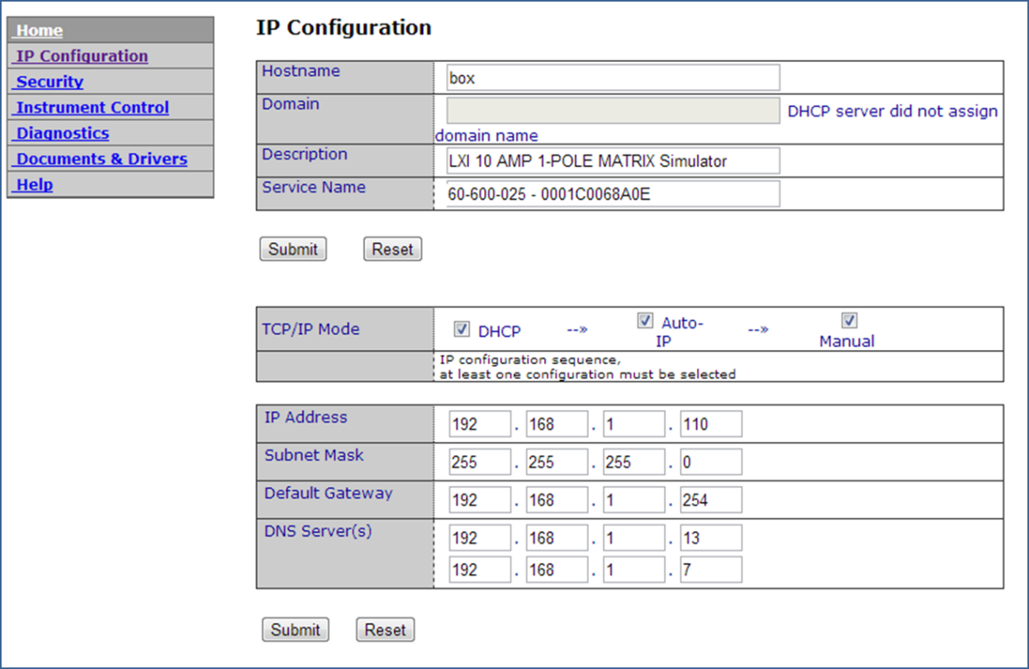
Configuring an LXI Device…
Notes:
All LXI Devices are required by the LXI Standard to provide a configuration Web Page. This allows the device to be custom configured for a particular subnet.
The default configuration from the Vendor is to request its IP Configuration from a DHCP Server, but as you can see from the example screen, one can force the device to use a Static IP Address (Manual Mode).

Slide 13
Using Private Subnet
Outside users must login to Test System computer
Greater Security - LXI Devices isolated from Company LAN
Typically use Static IP Addresses for easier documentation
Notes:
OK. Let’s describe that original recommended configuration.
Developers can login to the Test System Computer. Once in, they have access to all the LXI Devices through the second NIC port. There would be no provisions supplied to bridge the private subnet of NIC #2 to the company LAN through NIC #1…and hence you have greater security (isolation) for all of the LXI Devices. Typically, the LXI Devices would be assigned a Static IP Address. This makes documenting the Test System easier and is especially helpful to operators who may have limited knowledge of networking. Having an IP Address available in the documentation allows easy connection checking by using such things as Ping.

Slide 14

Next Steps – Guides/Videos for Using LXI
LXI Getting Started
Building LXI-Based Test Systems
Introducing LXI To Your Network Administrator
Maximizing Performance of LXI-Based Test System
Test Systems Using LXI
LXI Networking Basics
http://www.lxistandard.org/About/Guides-for-using-LXI.aspx
Notes:
You now have some good background on LXI Networking Basics. More detail can be found in the other guides listed and found on the LXI Consortium website.
Thank you for your time.

